Slide 1
An Intelligent Decision Support System for Sustainable Anthurium Farming
Specialization : Information Technology
Group ID : 25-26J-357

Slide 2
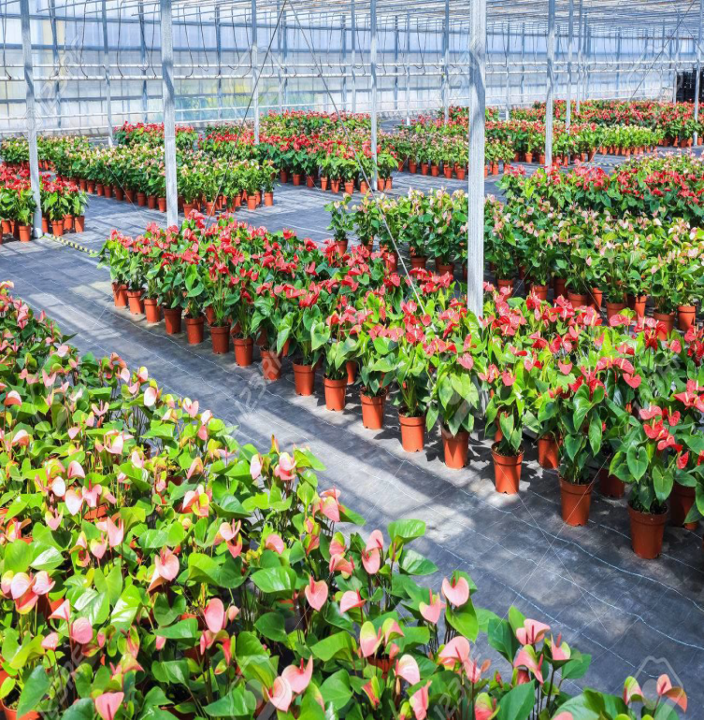
This system is designed as an intelligent decision-support platform for improving Anthurium cultivation management through data-driven technologies.
The Soil Management Module monitors soil conditions, analyzes collected data, and predicts optimal soil health to support better nutrient and irrigation decisions.
The Weather-Based Recommendation System integrates real-time weather data from external APIs and applies analytical models to generate adaptive cultivation recommendations for farmers.
The Disease Management Module uses image-based detection to identify plant diseases early and provide treatment suggestions along with reminder notifications for timely action.
The Market Prediction Module analyzes historical market data to forecast future price trends of Anthurium. A key feature of the system is the Sustainability Score, which evaluates trend level, risk, and market volatility to support more stable and sustainable farming decisions.
Together, these integrated modules create a smart ecosystem that enhances productivity, reduces risk, and improves economic outcomes for growers.
Introduction

Slide 3
Context and Domain
The cultivation of Anthurium, a high value ornamental crop, represents a significant segment within the floriculture industry. Despite its economic importance, the management of Anthurium production systems is frequently constrained by the absence of integrated decision support mechanisms capable of synthesizing market intelligence, environmental dynamics, and plant health indicators.

Slide 4
Stakeholders
Primary stakeholders consist of Anthurium cultivators whose production decisions directly depend on accurate environmental and economic insights.
Secondary stakeholders include agricultural consultants and agronomic researchers, while agricultural investors and supply chain decision makers are the broader strategic stakeholders.

Slide 5
Observed Issue
Current farming practices largely depend on experience-driven judgment and fragmented information sources, resulting in several systemic inefficiencies:
Inability to anticipate market price trajectories and associated volatility.
Delayed identification of plant diseases and physiological stress indicators.
Lack of adaptive irrigation strategies based on future climatic variability.
Limited understanding of soil nutrient dynamics and long-term soil sustainability.

Slide 6
Why It Matters
Current limitations create economic uncertainty and resource inefficiency for farmers
Increased vulnerability to environmental and market fluctuations
Reduces both farmer profitability and agricultural sustainability
Clear need for a data-driven, intelligent decision-support platform tailored specifically for Anthurium cultivation

Slide 7
Research Gap

Slide 8

WEATHER DETECTONG
&
WATERING SHEDULE SUGGETION MODULE
IT22109958| Soysa H. R. T.
Specialization : Information Technology
IT22109958 | Soysa H.R.T.

Slide 10

Market Analysis
&
Price Prediction Module
IT22117564| Peiris W.V.D
Specialization : Information Technology
IT22117564 | Peiris W.V.D

Slide 11
Research Gap
Existing price prediction models focus mostly on single-algorithm point estimates, lacking integration of hybrid/fusion models that leverage complementary strengths to improve predictive accuracy.
Current approaches rarely incorporate real time sustainability, trend, and risk assessment, leaving users unaware of whether the predicted price is reliable or actionable.
Existing approaches rarely integrate hybrid predictive models that combine deep learning for time-series patterns with statistical assessment of risk and sustainability, leaving a gap in actionable, decision-ready price intelligence.
No existing solution integrates accurate hybrid predictions with trend and risk evaluation to generate clear, sustainability-based recommendations too.

Slide 12
Pramudi

Slide 14
Semi

Slide 16
Solution Summary
A multi-module smart farming platform was developed to support sustainable Anthurium cultivation through predictive analytics and intelligent recommendations.

Slide 17
Core Modules Implemented
1. Price Prediction & Market Analysis
Fusion-based machine learning model predicts future Anthurium prices
Evaluates market volatility and sustainability
Provides sell / hold recommendations
2. Weather Forecast & Smart Irrigation
Predicts upcoming weather conditions
Suggests optimal watering schedules and quantities
3. Disease Detection & Recovery Recommendation
AI-based leaf image analysis
Identifies disease type, severity, and spread
Provides treatment and recovery guidance
4. Soil Health Monitoring
Evaluates soil moisture and nutrient levels
Generates soil health score
Recommends fertilizers and soil improvements

Slide 18
Non-Functional Focus
The system emphasizes:
Prediction accuracy
Reliability of recommendations
User-friendly interface
Scalability for smart farming environments
Current Status
System development progress: ~90%+ complete
All core modules implemented and integrated into a unified smart farming platform.

Slide 19
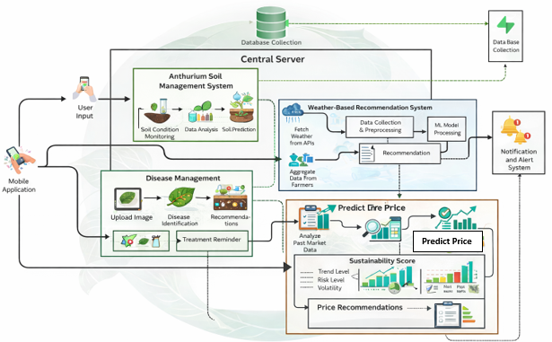
Diagram

Slide 20
Need a description about the diagram……….

Slide 21
Commercialization
Market Opportunity
The global ornamental flower industry is growing rapidly, with Anthurium being one of the most commercially valuable tropical flowers.
However, small and medium-scale farmers lack access to advanced decision-support technologies.
This creates a strong opportunity for smart farming platforms specialized for ornamental crops.
Potential Product Model
The proposed system can be commercialized as a:
Smart Agriculture Decision Support Platform
Possible delivery models include:
Subscription-based web platform for farmers
Mobile application for farm monitoring
Agricultural advisory tool for greenhouse management

Slide 22
Value Proposition
The system provides multiple economic benefits:
Increased crop yield and flower quality
Reduced disease-related losses
Optimized water and fertilizer usage
Improved market timing for selling flowers
These improvements directly increase farmer profitability and sustainability.

Slide 23
Budget
Requirement | Cost
Travelling cost for data collection | 11,000/=
Cost for deployment | 8,000/=(month)
Google map API | 3,500/=(month)
Price data set | 5,000/=(month)
Weather data set | 5,000/=(month)
Total | 32,500/=

Slide 24
Thank you!

